Slide 1
2812ICT Perceptual Computing
Image Representation & Processing

Slide 2
Outline
Image Filtering
Image Convolution

Slide 3
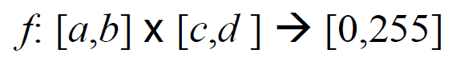
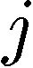
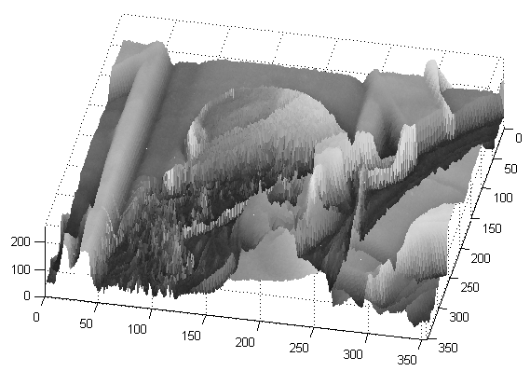
Images as Discrete Functions
We can think of an image as a function, f, from R² to R
f( x, y ) gives the intensity at position ( x, y )
Defined over a rectangle, with a finite range:
Images are usually digital (discrete)
Sample the 2D space on a regular grid
Represented as a matrix of integer values
A color image can be written as a “vector-valued” function:
f(x, y)
pixel
y
x

Slide 4
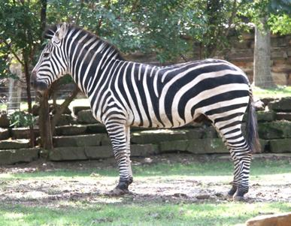

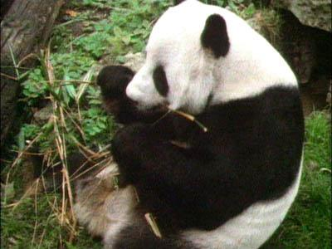
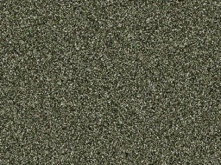
Image neighborhoods
Q: What happens if we reshuffle all pixels within the images?
A: Its histogram won’t change. Point-wise processing unaffected.
Need to measure properties relative to small neighborhoods of pixels

Slide 5
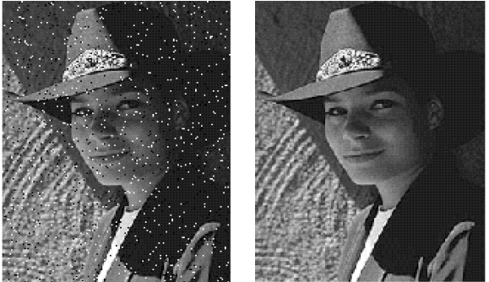
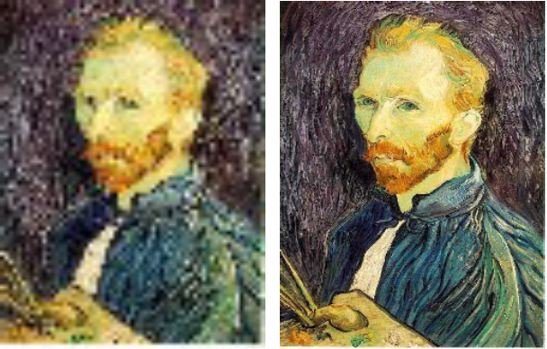
Image Filtering
Filtering:
Form a new image whose pixels are a combination of original pixel values
Goals:
Extract useful information from the images
Features (edges, corners, blobs…)
Modify or enhance image properties
de­‐noising; super-­resolution; in-­painting

Slide 6
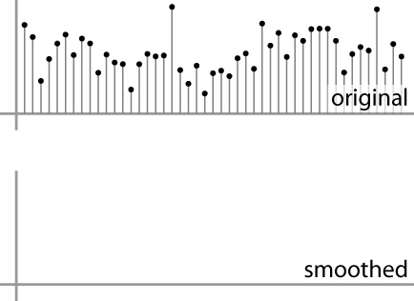
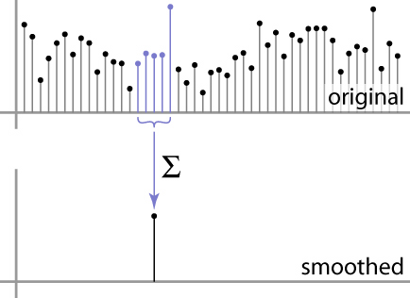
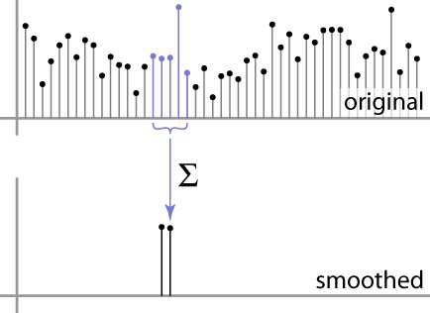
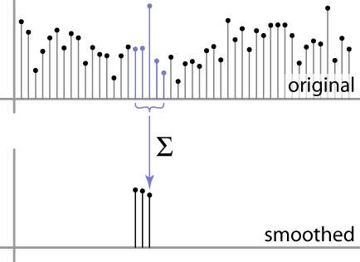
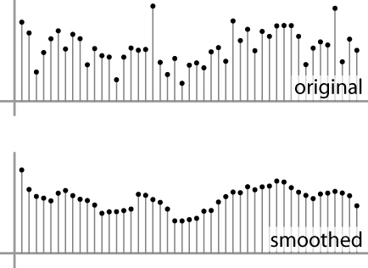
Filter example #1: Moving Average
Let’s replace each pixel with an average of all the values in its neighborhood
Eg. Neighborhood of +/- 2 pixels
Moving average in 1D:
Source: S. Marschner

Slide 7
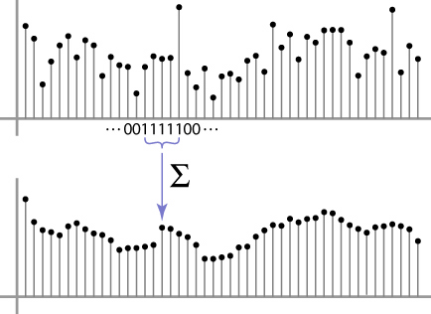
Weighted Moving Average
Can add weights to our moving average
Weights [1, 1, 1, 1, 1] / 5
Source: S. Marschner

Slide 8

Weighted Moving Average
Non-uniform weights [1, 4, 6, 4, 1] / 16
Source: S. Marschner

Slide 9
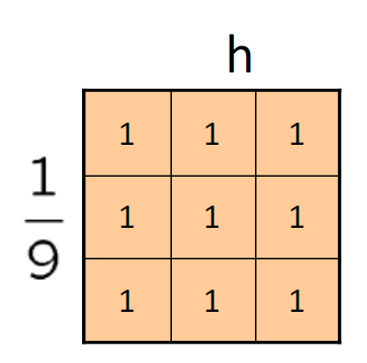
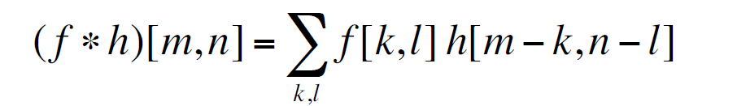
Moving Average In 2D
2D moving average over a 3 × 3 window of neighbourhood
A convolution operation:
Replaces each pixel with an average of its neighborhood.
Achieve smoothing effect (remove sharp features)

Slide 10
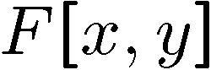
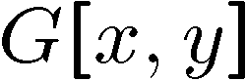
Moving Average In 2D
0 | 0 | 0 | 0 | 0 | 0 | 0 | 0 | 0 | 0
0 | 0 | 0 | 0 | 0 | 0 | 0 | 0 | 0 | 0
0 | 0 | 0 | 90 | 90 | 90 | 90 | 90 | 0 | 0
0 | 0 | 0 | 90 | 90 | 90 | 90 | 90 | 0 | 0
0 | 0 | 0 | 90 | 90 | 90 | 90 | 90 | 0 | 0
0 | 0 | 0 | 90 | 0 | 90 | 90 | 90 | 0 | 0
0 | 0 | 0 | 90 | 90 | 90 | 90 | 90 | 0 | 0
0 | 0 | 0 | 0 | 0 | 0 | 0 | 0 | 0 | 0
0 | 0 | 90 | 0 | 0 | 0 | 0 | 0 | 0 | 0
0 | 0 | 0 | 0 | 0 | 0 | 0 | 0 | 0 | 0
 | 0
0 | 0 | 0 | 0 | 0 | 0 | 0 | 0 | 0 | 0
0 | 0 | 0 | 0 | 0 | 0 | 0 | 0 | 0 | 0
0 | 0 | 0 | 90 | 90 | 90 | 90 | 90 | 0 | 0
0 | 0 | 0 | 90 | 90 | 90 | 90 | 90 | 0 | 0
0 | 0 | 0 | 90 | 90 | 90 | 90 | 90 | 0 | 0
0 | 0 | 0 | 90 | 0 | 90 | 90 | 90 | 0 | 0
0 | 0 | 0 | 90 | 90 | 90 | 90 | 90 | 0 | 0
0 | 0 | 0 | 0 | 0 | 0 | 0 | 0 | 0 | 0
0 | 0 | 90 | 0 | 0 | 0 | 0 | 0 | 0 | 0
0 | 0 | 0 | 0 | 0 | 0 | 0 | 0 | 0 | 0
Source: S. Seitz
Notes:
ones, divide by 9

Slide 11
Moving Average In 2D
0 | 0 | 0 | 0 | 0 | 0 | 0 | 0 | 0 | 0
0 | 0 | 0 | 0 | 0 | 0 | 0 | 0 | 0 | 0
0 | 0 | 0 | 90 | 90 | 90 | 90 | 90 | 0 | 0
0 | 0 | 0 | 90 | 90 | 90 | 90 | 90 | 0 | 0
0 | 0 | 0 | 90 | 90 | 90 | 90 | 90 | 0 | 0
0 | 0 | 0 | 90 | 0 | 90 | 90 | 90 | 0 | 0
0 | 0 | 0 | 90 | 90 | 90 | 90 | 90 | 0 | 0
0 | 0 | 0 | 0 | 0 | 0 | 0 | 0 | 0 | 0
0 | 0 | 90 | 0 | 0 | 0 | 0 | 0 | 0 | 0
0 | 0 | 0 | 0 | 0 | 0 | 0 | 0 | 0 | 0
 | 0 | 10
0 | 0 | 0 | 0 | 0 | 0 | 0 | 0 | 0 | 0
0 | 0 | 0 | 0 | 0 | 0 | 0 | 0 | 0 | 0
0 | 0 | 0 | 90 | 90 | 90 | 90 | 90 | 0 | 0
0 | 0 | 0 | 90 | 90 | 90 | 90 | 90 | 0 | 0
0 | 0 | 0 | 90 | 90 | 90 | 90 | 90 | 0 | 0
0 | 0 | 0 | 90 | 0 | 90 | 90 | 90 | 0 | 0
0 | 0 | 0 | 90 | 90 | 90 | 90 | 90 | 0 | 0
0 | 0 | 0 | 0 | 0 | 0 | 0 | 0 | 0 | 0
0 | 0 | 90 | 0 | 0 | 0 | 0 | 0 | 0 | 0
0 | 0 | 0 | 0 | 0 | 0 | 0 | 0 | 0 | 0
Source: S. Seitz
Notes:
ones, divide by 9

Slide 12
Moving Average In 2D
0 | 0 | 0 | 0 | 0 | 0 | 0 | 0 | 0 | 0
0 | 0 | 0 | 0 | 0 | 0 | 0 | 0 | 0 | 0
0 | 0 | 0 | 90 | 90 | 90 | 90 | 90 | 0 | 0
0 | 0 | 0 | 90 | 90 | 90 | 90 | 90 | 0 | 0
0 | 0 | 0 | 90 | 90 | 90 | 90 | 90 | 0 | 0
0 | 0 | 0 | 90 | 0 | 90 | 90 | 90 | 0 | 0
0 | 0 | 0 | 90 | 90 | 90 | 90 | 90 | 0 | 0
0 | 0 | 0 | 0 | 0 | 0 | 0 | 0 | 0 | 0
0 | 0 | 90 | 0 | 0 | 0 | 0 | 0 | 0 | 0
0 | 0 | 0 | 0 | 0 | 0 | 0 | 0 | 0 | 0
 | 0 | 10 | 20
0 | 0 | 0 | 0 | 0 | 0 | 0 | 0 | 0 | 0
0 | 0 | 0 | 0 | 0 | 0 | 0 | 0 | 0 | 0
0 | 0 | 0 | 90 | 90 | 90 | 90 | 90 | 0 | 0
0 | 0 | 0 | 90 | 90 | 90 | 90 | 90 | 0 | 0
0 | 0 | 0 | 90 | 90 | 90 | 90 | 90 | 0 | 0
0 | 0 | 0 | 90 | 0 | 90 | 90 | 90 | 0 | 0
0 | 0 | 0 | 90 | 90 | 90 | 90 | 90 | 0 | 0
0 | 0 | 0 | 0 | 0 | 0 | 0 | 0 | 0 | 0
0 | 0 | 90 | 0 | 0 | 0 | 0 | 0 | 0 | 0
0 | 0 | 0 | 0 | 0 | 0 | 0 | 0 | 0 | 0
Source: S. Seitz
Notes:
ones, divide by 9

Slide 13
Moving Average In 2D
0 | 0 | 0 | 0 | 0 | 0 | 0 | 0 | 0 | 0
0 | 0 | 0 | 0 | 0 | 0 | 0 | 0 | 0 | 0
0 | 0 | 0 | 90 | 90 | 90 | 90 | 90 | 0 | 0
0 | 0 | 0 | 90 | 90 | 90 | 90 | 90 | 0 | 0
0 | 0 | 0 | 90 | 90 | 90 | 90 | 90 | 0 | 0
0 | 0 | 0 | 90 | 0 | 90 | 90 | 90 | 0 | 0
0 | 0 | 0 | 90 | 90 | 90 | 90 | 90 | 0 | 0
0 | 0 | 0 | 0 | 0 | 0 | 0 | 0 | 0 | 0
0 | 0 | 90 | 0 | 0 | 0 | 0 | 0 | 0 | 0
0 | 0 | 0 | 0 | 0 | 0 | 0 | 0 | 0 | 0
 | 0 | 10 | 20 | 30
0 | 0 | 0 | 0 | 0 | 0 | 0 | 0 | 0 | 0
0 | 0 | 0 | 0 | 0 | 0 | 0 | 0 | 0 | 0
0 | 0 | 0 | 90 | 90 | 90 | 90 | 90 | 0 | 0
0 | 0 | 0 | 90 | 90 | 90 | 90 | 90 | 0 | 0
0 | 0 | 0 | 90 | 90 | 90 | 90 | 90 | 0 | 0
0 | 0 | 0 | 90 | 0 | 90 | 90 | 90 | 0 | 0
0 | 0 | 0 | 90 | 90 | 90 | 90 | 90 | 0 | 0
0 | 0 | 0 | 0 | 0 | 0 | 0 | 0 | 0 | 0
0 | 0 | 90 | 0 | 0 | 0 | 0 | 0 | 0 | 0
0 | 0 | 0 | 0 | 0 | 0 | 0 | 0 | 0 | 0
Source: S. Seitz
Notes:
ones, divide by 9

Slide 14
Moving Average In 2D
0 | 0 | 0 | 0 | 0 | 0 | 0 | 0 | 0 | 0
0 | 0 | 0 | 0 | 0 | 0 | 0 | 0 | 0 | 0
0 | 0 | 0 | 90 | 90 | 90 | 90 | 90 | 0 | 0
0 | 0 | 0 | 90 | 90 | 90 | 90 | 90 | 0 | 0
0 | 0 | 0 | 90 | 90 | 90 | 90 | 90 | 0 | 0
0 | 0 | 0 | 90 | 0 | 90 | 90 | 90 | 0 | 0
0 | 0 | 0 | 90 | 90 | 90 | 90 | 90 | 0 | 0
0 | 0 | 0 | 0 | 0 | 0 | 0 | 0 | 0 | 0
0 | 0 | 90 | 0 | 0 | 0 | 0 | 0 | 0 | 0
0 | 0 | 0 | 0 | 0 | 0 | 0 | 0 | 0 | 0
 | 0 | 10 | 20 | 30 | 30
Source: S. Seitz
Notes:
ones, divide by 9

Slide 15
Moving Average In 2D
0 | 0 | 0 | 0 | 0 | 0 | 0 | 0 | 0 | 0
0 | 0 | 0 | 0 | 0 | 0 | 0 | 0 | 0 | 0
0 | 0 | 0 | 90 | 90 | 90 | 90 | 90 | 0 | 0
0 | 0 | 0 | 90 | 90 | 90 | 90 | 90 | 0 | 0
0 | 0 | 0 | 90 | 90 | 90 | 90 | 90 | 0 | 0
0 | 0 | 0 | 90 | 0 | 90 | 90 | 90 | 0 | 0
0 | 0 | 0 | 90 | 90 | 90 | 90 | 90 | 0 | 0
0 | 0 | 0 | 0 | 0 | 0 | 0 | 0 | 0 | 0
0 | 0 | 90 | 0 | 0 | 0 | 0 | 0 | 0 | 0
0 | 0 | 0 | 0 | 0 | 0 | 0 | 0 | 0 | 0
 | 0 | 10 | 20 | 30 | 30 | 30 | 20 | 10
 | 0 | 20 | 40 | 60 | 60 | 60 | 40 | 20
 | 0 | 30 | 60 | 90 | 90 | 90 | 60 | 30
 | 0 | 30 | 50 | 80 | 80 | 90 | 60 | 30
 | 0 | 30 | 50 | 80 | 80 | 90 | 60 | 30
 | 0 | 20 | 30 | 50 | 50 | 60 | 40 | 20
 | 10 | 20 | 30 | 30 | 30 | 30 | 20 | 10
 | 10 | 10 | 10 | 0 | 0 | 0 | 0 | 0
Source: S. Seitz
Notes:
ones, divide by 9

Slide 16
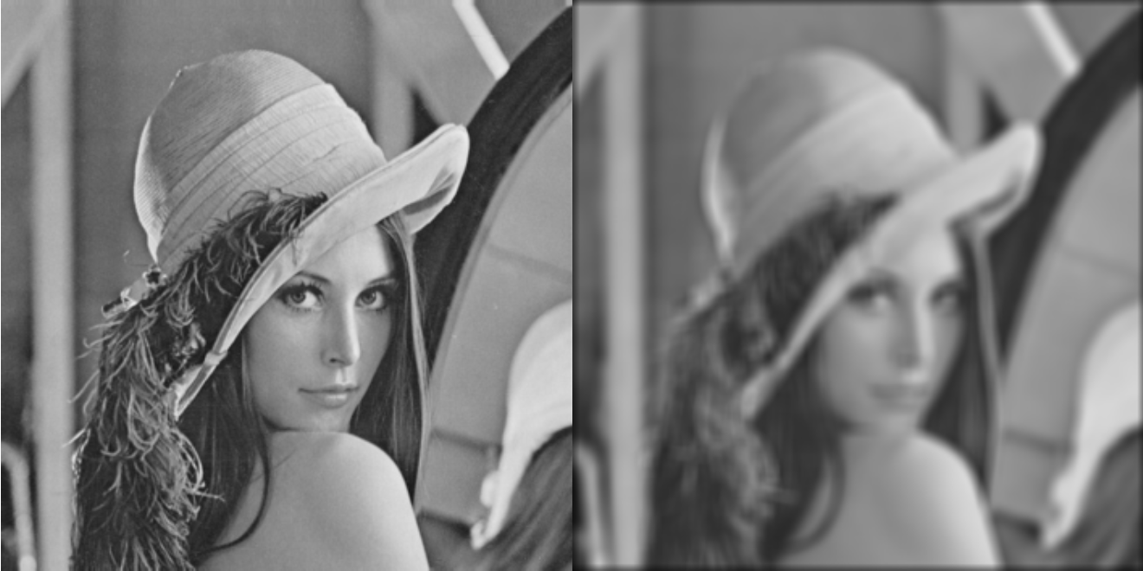
Moving Average In 2D
Notes:
ones, divide by 9

Slide 17
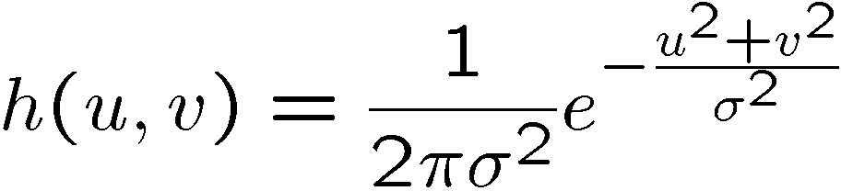
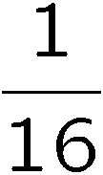
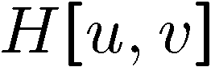
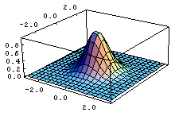
Gaussian filter
What if we want nearest neighboring pixels to have the most influence on the output?
This kernel is an approximation of a Gaussian function:
0 | 0 | 0 | 0 | 0 | 0 | 0 | 0 | 0 | 0
0 | 0 | 0 | 0 | 0 | 0 | 0 | 0 | 0 | 0
0 | 0 | 0 | 90 | 90 | 90 | 90 | 90 | 0 | 0
0 | 0 | 0 | 90 | 90 | 90 | 90 | 90 | 0 | 0
0 | 0 | 0 | 90 | 90 | 90 | 90 | 90 | 0 | 0
0 | 0 | 0 | 90 | 0 | 90 | 90 | 90 | 0 | 0
0 | 0 | 0 | 90 | 90 | 90 | 90 | 90 | 0 | 0
0 | 0 | 0 | 0 | 0 | 0 | 0 | 0 | 0 | 0
0 | 0 | 90 | 0 | 0 | 0 | 0 | 0 | 0 | 0
0 | 0 | 0 | 0 | 0 | 0 | 0 | 0 | 0 | 0
1 | 2 | 1
2 | 4 | 2
1 | 2 | 1
Source: S. Seitz

Slide 18
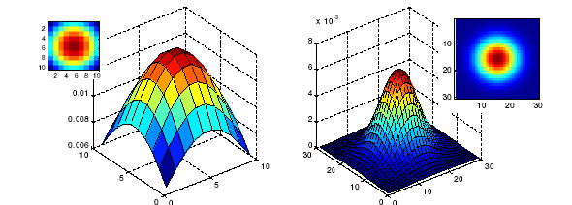
Gaussian filters
What parameters matter here?
Size of kernel or mask
Note, Gaussian function has infinite support, but discrete filters use finite kernels
σ = 5 with 10 x 10 kernel
σ = 5 with 30 x 30 kernel

Slide 19
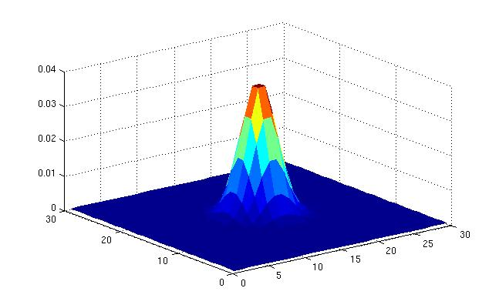
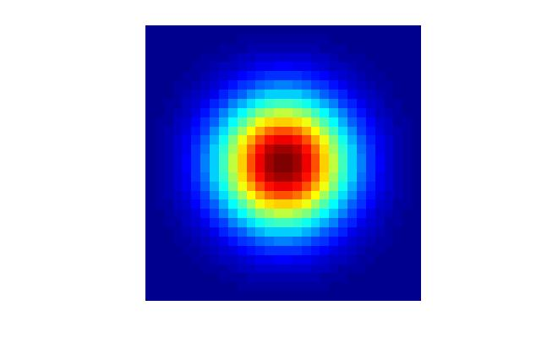
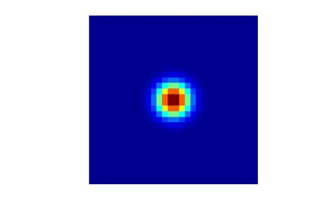
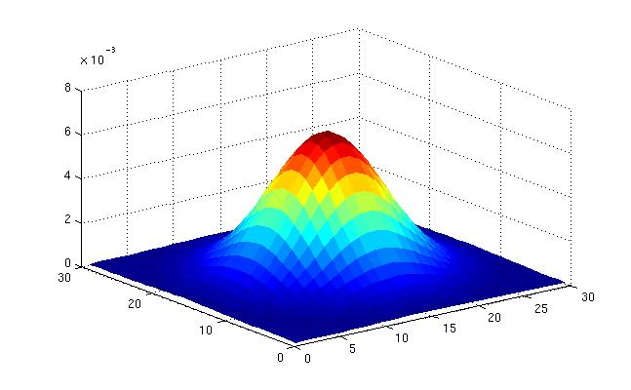
Gaussian filters
What parameters matter here?
Variance of Gaussian: determines extent of smoothing
σ = 2 with 30 x 30 kernel
σ = 5 with 30 x 30 kernel

Slide 20
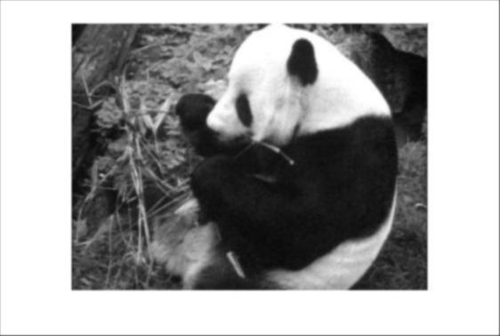
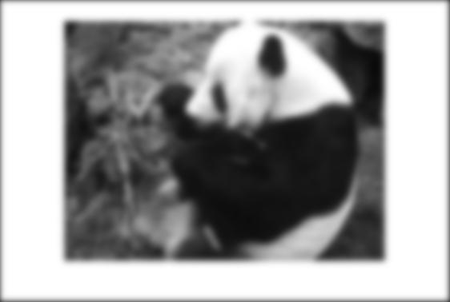
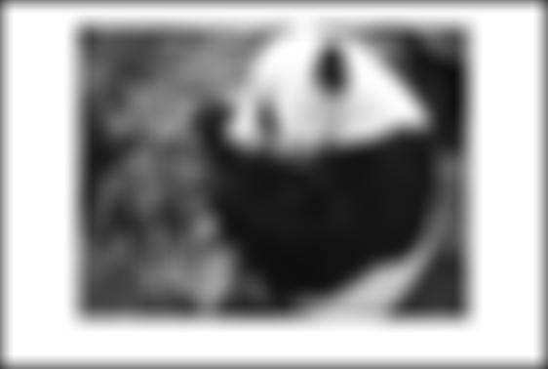
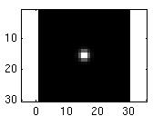
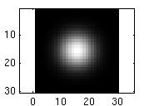
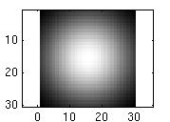
Smoothing with a Gaussian
Parameter σ is the “scale” / “width” / “spread” of the Gaussian kernel, and controls the amount of smoothing.
…

Slide 21













Boundary issues
What about near the edge?
the filter window falls off the edge of the image
need to extrapolate
methods:
clip filter (black)
wrap around
copy edge
reflect across edge
Source: S. Marschner

Slide 22
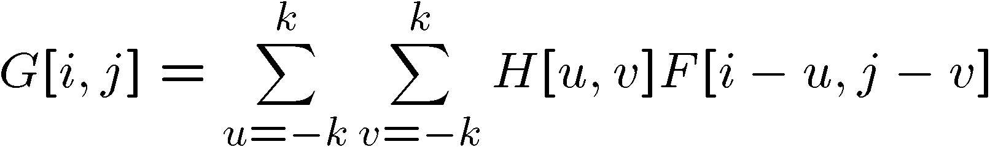

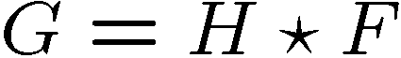
Convolution
Convolution:
Flip the filter in both dimensions (bottom to top, right to left)
Then apply cross-correlation
F
H
Notation for convolution operator

Slide 23
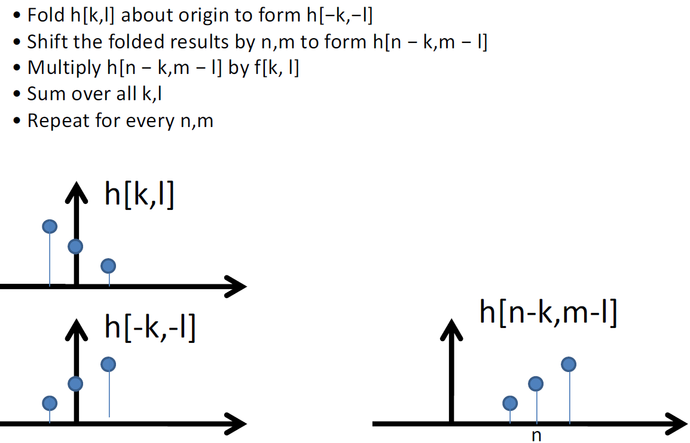
Convolution in operation
Source: Fei-Fei Li

Slide 24
Convolution in operation
Source: Fei-Fei Li

Slide 25
Shift invariant linear system
Shift invariant:
Operator behaves the same everywhere, i.e. the value of the output depends on the pattern in the image neighborhood, not the position of the neighborhood.
Linear:
Superposition: h * (f1 + f2) = (h * f1) + (h * f2)
Scaling: h * (k f) = k (h * f)

Slide 26

Properties of convolution
Linear & shift invariant
Commutative:
f * g = g * f
Associative
(f * g) * h = f * (g * h)
Identity:
unit impulse e = […, 0, 0, 1, 0, 0, …]. f * e = f
Differentiation:

Slide 27
Separability
In some cases, filter is separable, and we can factor into two steps:
Convolve all rows
Convolve all columns

Slide 28
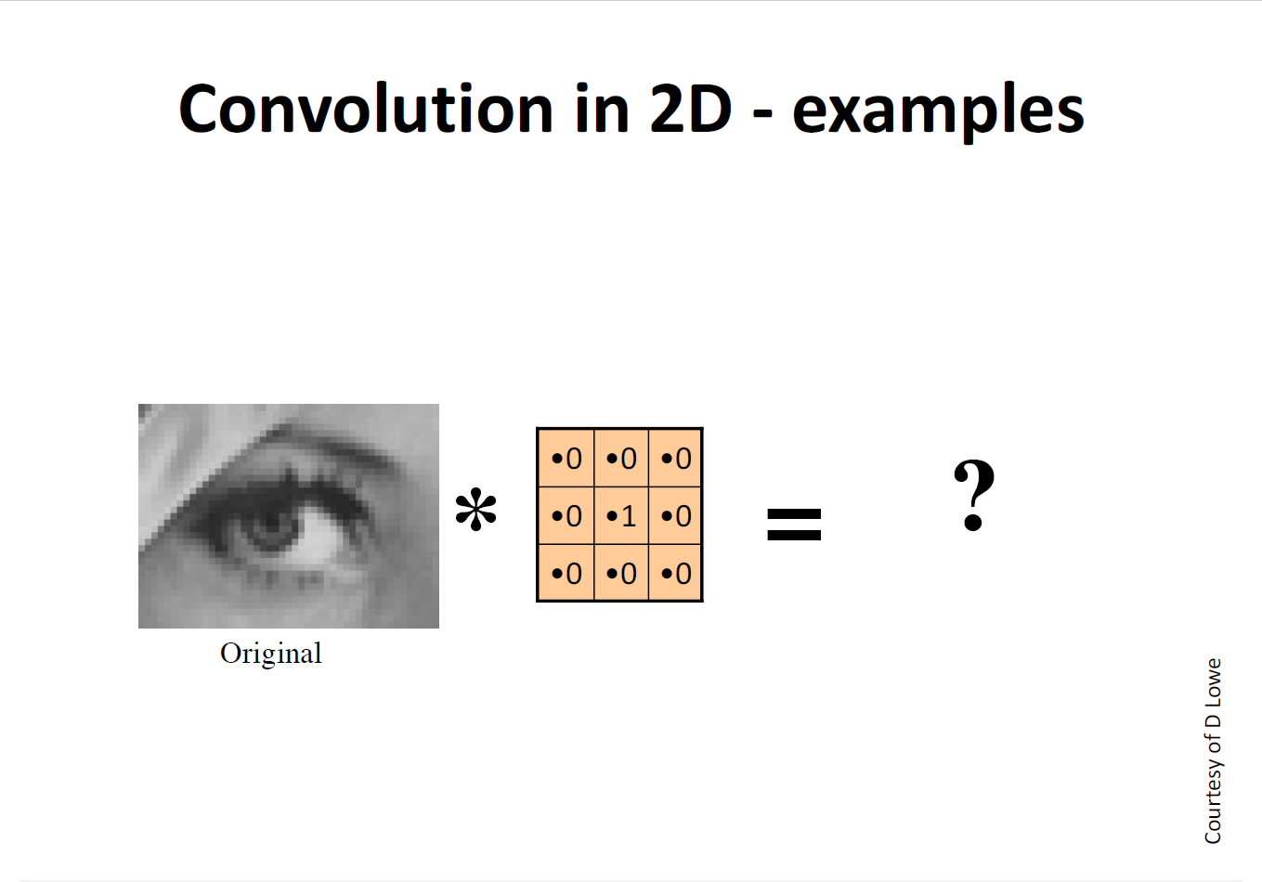

Slide 29
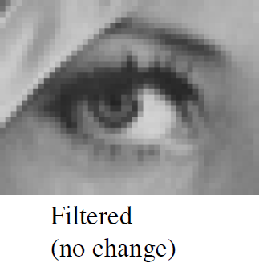

Slide 30
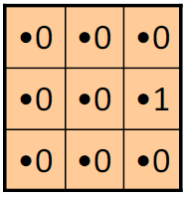

Slide 31
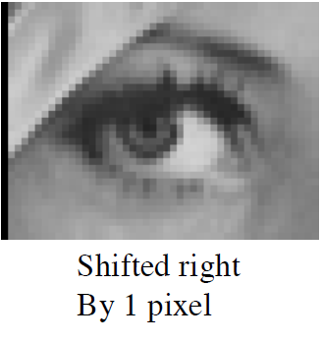

Slide 32
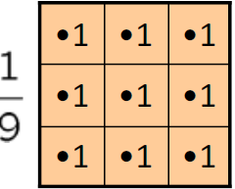

Slide 33
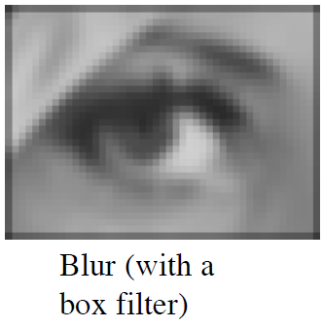

Slide 34
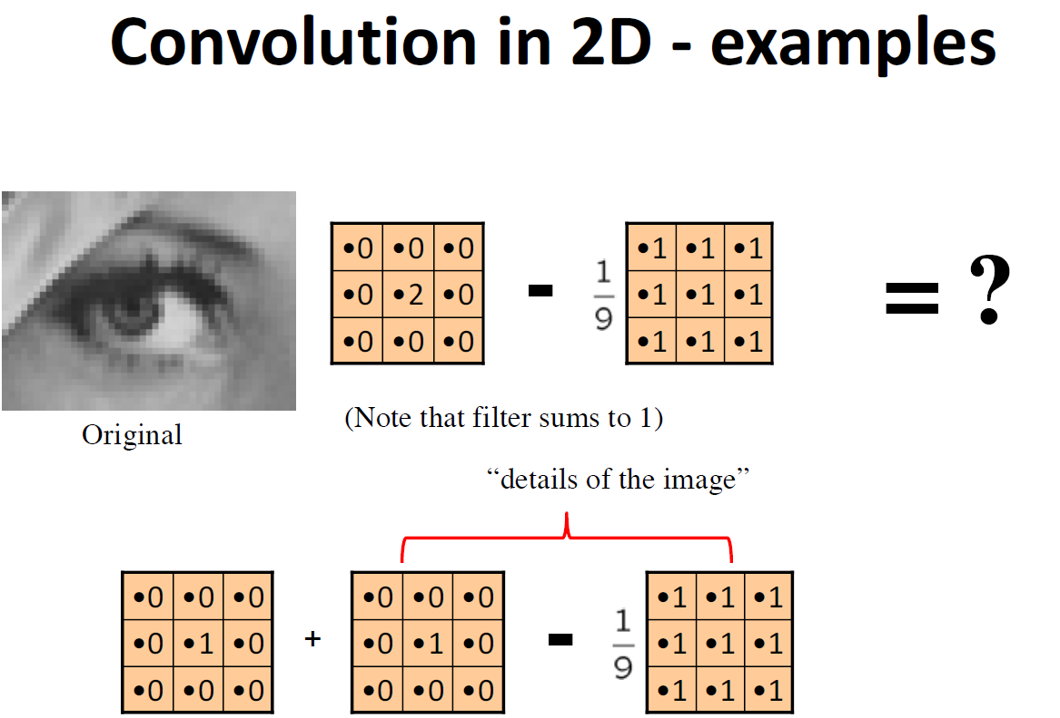

Slide 35
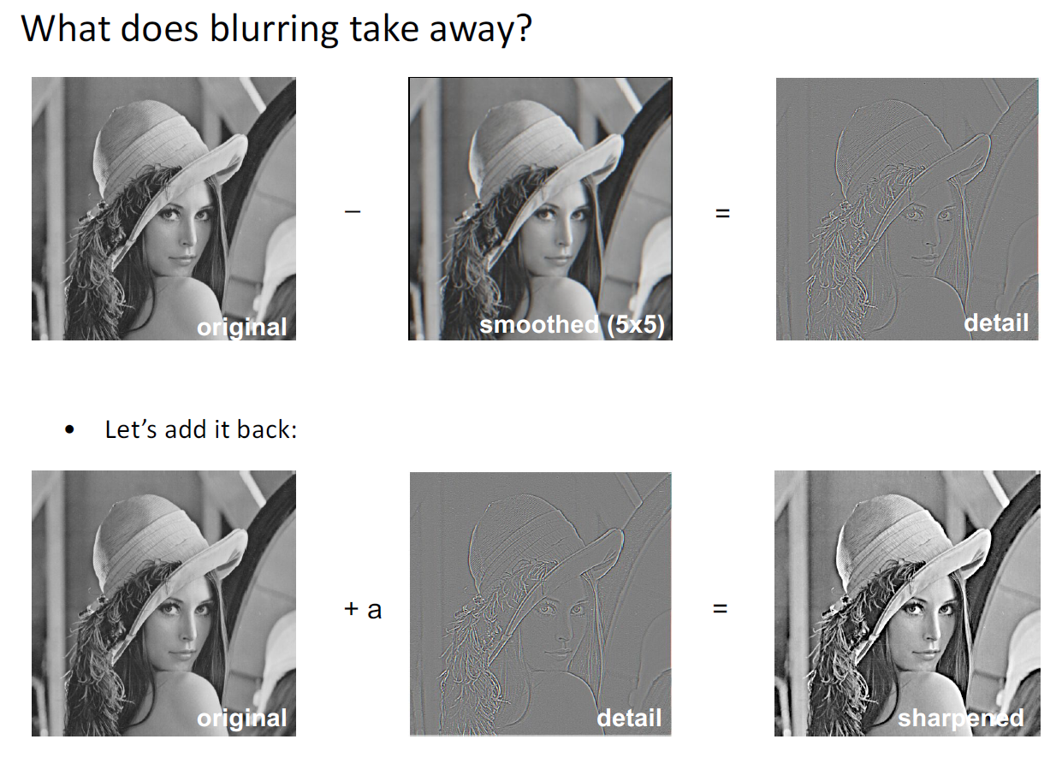

Slide 36
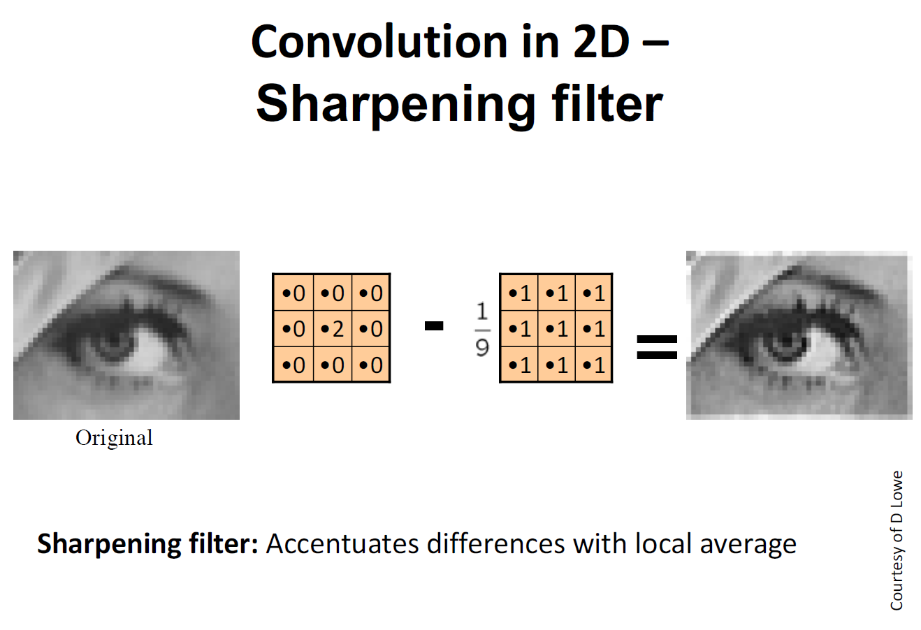

Slide 37
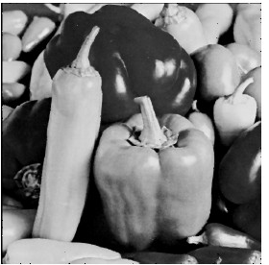
Filters for features
Filters allow us to abstract higher-level “features”.
Map raw pixels to an intermediate representation that will be used for subsequent processing
Goal: reduce amount of data, discard redundancy, preserve what’s useful

Slide 38
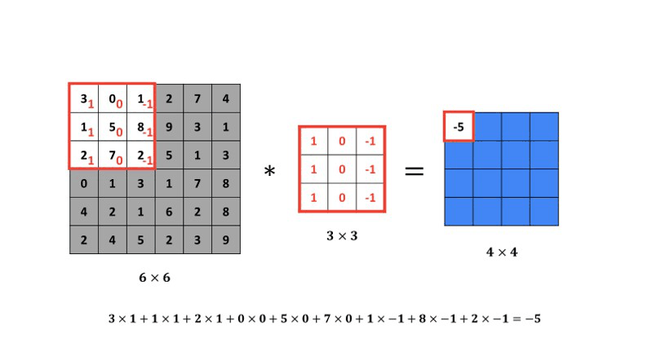
Example: Edge detection through convolution
Vertical edges
Horizontal edges

Slide 39
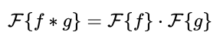
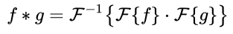
Fast convolution (optional)
Convolution can be done efficiently in the frequency domain through the use of Fast Fourier Transform.
The Convolution Theorem (https://en.wikipedia.org/wiki/Convolution_theorem) stated that under suitable conditions the Fourier transform of a convolution is the pointwise product of the Fourier transforms, i.e.
In other words, we can perform a convolution by taking the Fourier transform of both functions, multiplying the results, and then performing an inverse Fourier transform
Convolution theorem is used extensively in audio signal analysis and image filtering operations.

Slide 40
Next week:
Correlation and template matching

